Slide 1
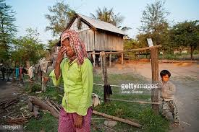
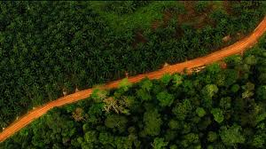
HOW I HAVE COME TO KNOW THE ASSAULT OF GLOBAL NEOLIBERAL CAPITALISM ON THE POOR & ENVIRONMENT [THE CHURCH’S NEW MISSION FRONTIER]
PRESENTED AT GEM SCHOOL CONFERENCE
JAKARTA –INDONESIA 19 – 30TH AUGUST 2019
By AlEXANDER JEBADU
&
MY EXPECTATION FROM GEM SCHOOL
By Alexander Jebadu SVD

Slide 2
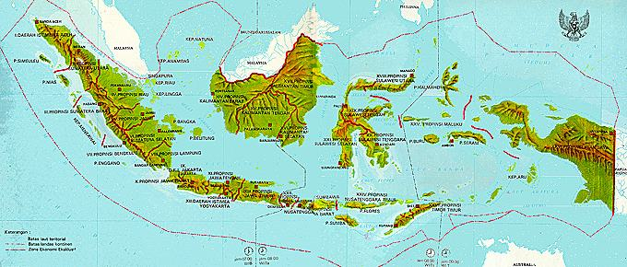
= An Indonesian, from eastern part of Indonesia (Flores Island). = A Catholic priest that belongs to the Society of Divine Word (SVD – ….), rooted and based in Germany since 1875. = I have had an opportunity to serve the Lord in USA for 6 years (1998 – 2004). = I completed doctoral studies in Missiology at PUG, Rome in 2014 = Since 2014 I have been teaching MISSIOLOGY, THEOLOGY OF MISSION, INDONESIAN POLITICS, TRADITIONAL RELIGIONS & THE THREATS OF NEOLIBERAL CAPITALISM as THE ROOT CAUSE OF THE DEGRADATION OF HUMAN CIVILIZATION & ECOLOGY .
A SHORT SELF-INTRODUCTION:

Slide 3
The Country’s Current Socio-Economic Context.
IT FACES
FIVE CHALLENGING
SOCIAL, ECONOMIC & POLITICAL
MALADIES
INDONESIA IS IN PERIL

Slide 4
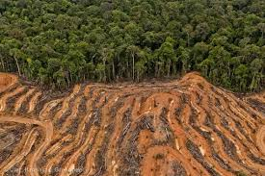
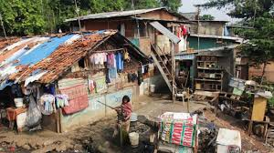
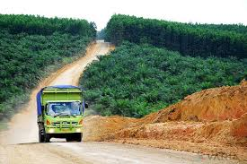
.
# One:
INEQUALITY BETWEEN THE FEW RICH & MAJORITY POOR
INDONESIA is one of the RICHEST COUNTRIES on this planet BASED on its very abundant natural resources.
Yet till today it is still considered a poor country.
60% of its population still live on less than 2 dollars a day.
IT’S NATIONAL WEALTH is still controled by A FEW RICH !
1% of Indonesia's Richest People Control 45% of its National Wealth.
Or 10% of the richest people in Indonesia control 74.8% of national wealth.

Slide 5
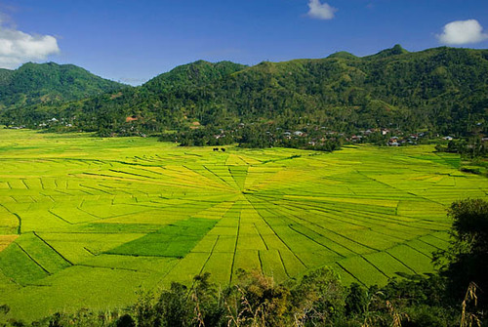
.
# TWO:
URBANIZATION & REGIONAL INEQUALITY
Due to a tremendous inequal distributionof economic development between Java island and the country’s other 17.000 islands and between urban areas and rural areas:
Since 1971 up to this day, more than 60% of
Indonesia’s population have concentrated in Java.
In 2015, for the first time, 52.4% of the country’
population lived in urban ares and it is estimated
that in 2020: 55.5% & in 2025: 58.3%.
This is an anomaly since Indonesia is not an
industrial country. Majority of its population still
rely heavily on agricultural sector!

Slide 6
.
# THREE:
RAMPANT PUBLIC CORRUPTION
INDONESIA is still ONE of THE MOST CORRUPT countries in the world.
Its public corruption is pervasive.
It is cancerous and almost untreable. .
It is triggered and has become more pervasive by the capitalistic model of development.

Slide 7
.
# FOUR:
RAMPANT VIOLATION OF HUMAN RIGHTS
Even though INDONESIA is based on the rule of law, it is still widely known as one of the countrie with a poor record on human rigths.
Most of its human right violations have something to do with conflicts over natural resources that are mostly found:
a) beneath the farming lands of the country’s
rural populations
b) or beneath the pockets of its legally
protected rainforests.

Slide 8
.
# FIVE:
THE ESCALATION OF TRANSNATIONAL CORPORATIONS’ INVASION INCLUDING IN MINING SECTOR
Since the fall of Suharto regime in 1998, INDONESIA’S FATE has also been marked by an ESCALATION of TNCs’ INVASION toward all its economic resources including MINING SECTOR.
The country’s rural populations HAVE BEEN TERRORIZED by the presence of extractive industry unilaterally carried out by the country’s corrupt goverments & TNCs without free and prior informed consent of the rural communities.

Slide 9
THE TERROR OF THE GLOBAL UNFETTERED FREE MARKET ECONOMY
While also teaching THEOLOGY at a Catholic Seminry Institute in Flores, Indonesia, since 2006, I actively worked hand-in-hand with the Commission of SVD Indonesia JPIC (Justice and Integrity of Creation) and OFM Indonesia JPIC in advocating the poor rural farming communities in Flores Island and beyond who were struggling to defend their farmlands from assaults of the extractive industry operated by transnational mining corporations who received ill-blessings from corrupt Indonesian officials.
After Indonesia passed political reform in 1998, marked by the fall of the Suharto regime, the poor rural farming communities in Flores Island, and other rural farming communities throughout Indonesia, have been terrorized by a massive invasion of transnational corporations (TNCs) in the mining sector.
After “buying” Indonesian politicians and local governments, these TNCs massively exploited all kinds of minerals by mercilessly destroying pockets of protected rainforests and farms of rural communities, without their permission as owners of the land, with very little compensation and often without any compensation at all and without an environmental and social impact assessment (ESIA).

Slide 10
.
In the process of its operation, this extractive industry is full of corruption, frauds and manipulations. Without any doubt, the rural farming communities have cried out because they are oppressed, impoverished and their future has been killed by mercilessly destroying the sources of their livelyhoods: their legally protected rainforests, their farms and water springs.
This tragedy provokes various questions. Why do these things happen to them? What has been on? Why are the members of house representatives and governments they elected in alliance with TNCs destroying their sources and rights for livelihood? How should the Church prophetically face this travesty in colaboration with followers of other religions and with all people of good will? And there are still other problematic questions that can be raised.
Part of our prophetic liberative voice in regard to this terrible issue can be seen in JEBADU Alex (eds.), Pertambangan di Flores: Berkah atau Kutuk/Mining Industry in Flores: Is It a Blessing or a Curse? (Maumere, Flores/Indonesia: Penerbit Ledalero, 2009).

Slide 11
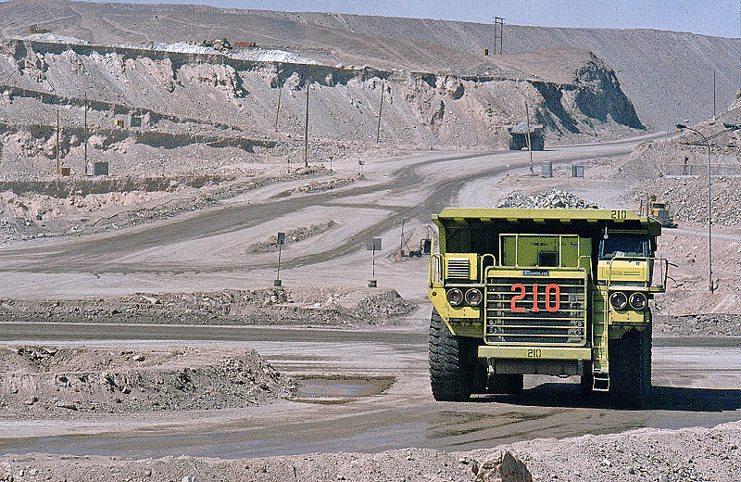
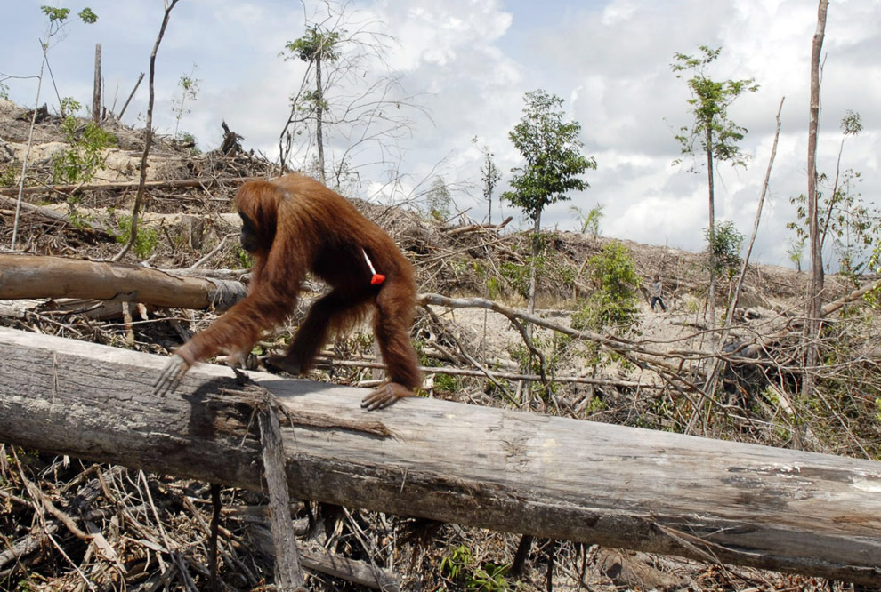
.
The aforementioned human and ecological tragedy has become my academic work and its fruit has become my doctoral dissertation entitled :
The Impacts of
Ecological Exploitation
on People and Nature:
A Missiological Investigation on the Threat of Neoliberal Capitalism with a Study Case of Mining Industry in Flores Island-Indonesia

Slide 12
.
In this academic research, I discovered that the world’s current social, economic and political chaos, that has befallen the so-called poor developing countries, including Indonesia, cannot be well understood without learning to know its main culprits – that is,:
1) Neoliberal economic regime or unfettered free
market economic system and
2) Transnational corporations as its brokers.
This neoliberal economic regime definitely poses a threat that can destroy almost everything:
1) human civilization, 2) the dignity of human
person, 3) environment, 4) democracy and 5) state
sovereignty.

Slide 13
,
Neoliberal capitalism has been secretly designed only to enrich the world’s relative few that are already rich, and further impoverish the world’s majority poor.
Its main culprits are a few super-rich from the G-7/8 countries and other newly industrialized countries (NICs).
The instruments used are the international financial institutions (the World Bank, IMF) and WTO.
Its brokers or executors are the TNCs.
Clearly it is a massive and structured neocolonialism, yet the way it operates is very soft and invisible since it comes in through a market economic system by using a mask of economic theory with a flag of illusive freedom.

Slide 14
.
From the perspective of our Christian faith, the threats posed by the neoliberal economic system requires a prophetic liberative response from all Christian Churches, in colaboration with the followers of other religions, and with all people of good will.
My in-depth study on this subject agues that standing in solidarity with the poor rural farming communities in Indonesia, and throughout developing world, that have been struggling to defend their lives against this economic system, is a constitutive part of the Church’s new evangelization.
It is one of the Church’s new mission frontiers. This neoliberal economic system is against the values of the Gospel, against the state, against democracy and it destroys human civilization and planet earth as said by Ross Jackson:
“Indeed, if the objective of someone was to drive our civilization to ruin, nothing could do it more effectively than by the invention of the currently dominant economic system – neoliberalism” (Ross Jackson, Occupy World Street: A Global Roadmap for Radical Economic and Political Reform, 2012:51).

Slide 15
PROPHETIC WARNING OF THE CHURCH SINCE 1961:
The Catholic Church herself, through her Social Teachings, already gave a warning to the world society in 1961 in Mater et Magistra and in 1965 in Populorum Prgressio regarding a number of unjust aspects of liberal capitalism that today threatens the fate of the human family and planet earth as its common home.
According to my observation in my academic research, however, prophetic critics of the Church’s social teachings toward liberal capitalism are very often launched in a language that most people, even including the Church’s pastoral agents themselves who study philosophy and theology, find it difficult to understand.
I argue that for pastoral agents of the Church and for all people of good will, learning to understand Social Teaching of the Church must be done hand-in-hand with a study to understand the unjust system of neolieberal economic capitalism today.
To better understand the Social Teaching of the Church, especially the parts that relate to authentic human development, economy and politics, a study regarding the system of unfettered neocapitalism today is a must.

Slide 16
Its various names:
Neo-conservatism!
Free market Capitalism!
Neoliberal Capitalism!
Laissez-fair Neo-capitalism!
Market Fundamentalism!
Neoclassical Orthodoxy!
Wild Capitalism!
Jungle Capitalism!
Barbaric Capitalism
Unfettered Free Market Economy!
Raegenomics / Thatcherism (1980s)!

Slide 17
Adam Smith’s Classical Liberal Capitalism
Regulated Liberal Capitalism
Unfettered Neoliberal Capitalism
1995 WTO
18th Century
19th century
1944
1980
1989
INDUSTRIAL REVOLUTION that gave birth to LIBERAL CAPITALISM
SOCIAL ECONOMY (Socialism / Communism born as a reaction toward unjust LIBERAL CAPITALISM
1st and 2nd World War: TRIGGERED by unjust classical liberal capitalism
COLD WAR: Western Block (Liberal Capitalism vs Estern Block (Sosialism/ Communism)
THE FALL OF COMMUNISM

Slide 18
The major findings and contribution of this study as one of the Church’s new mission frontiers can be summarized as follows:
The Mining Industry (MI) in Flores, Indonesia, and beyond is not business per se but a crime of corporatocracy.
The MI in Flores and beyond is part of global looting.
The EI has not improved the economy of the rural communities.
The MI enriches the rich but impoverishes the poor.
The EI is operated by corporations shielded with a corporate veil that makes them have no fear of breaking laws or commit any crime trampling the rights of the poor, and excessively exploiting nature.
The invasion of TNCs has been accelerated by Laissez-Faire Neo-capitalism that is by design unjust, anti-democracy, anti-state, anti-common good and unfriendly to ecology.

Slide 19
.
Being aware that this missionary endeavor is big, complex and difficult, it requires a set of pastoral approaches:
The Church needs a pastoral shift from curative mission to preventive mission;
In order to liberate the poor & all God’s creaion, there is a need of catechesis on human rights, macroeconomics, politics and ecology in the mission of our Churches today.
The urgent and complex scope of this mission requires our Churches to work togehter & cooperate in love with other religions and all people of good will.

Slide 20
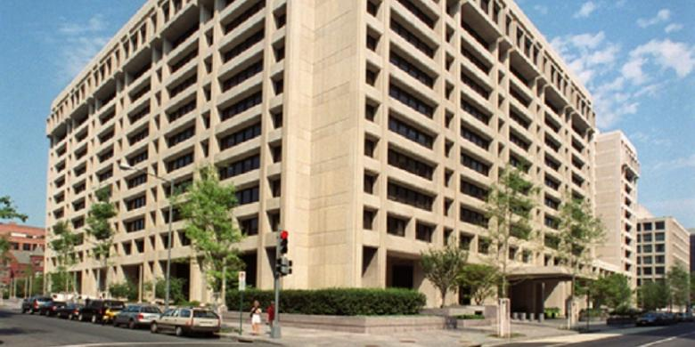
The Main of Office of IMF in DC, USA

Slide 21
The Main Offic of the World Bank in DC, USA
IMF

Slide 22
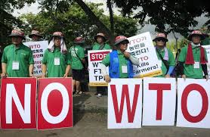
Various Global Protests against Unjust Nelibearl Capitalism!

Slide 23
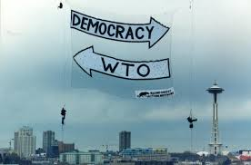

Slide 24
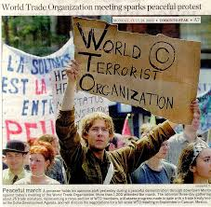

Slide 25
PROTEST against IMF

Slide 26
.

Slide 27
.

Slide 28
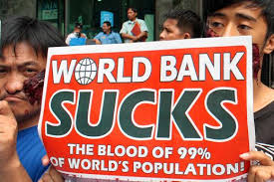
.

Slide 29
.

Slide 30
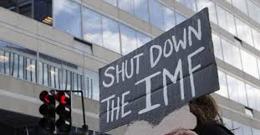
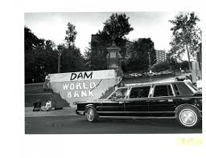
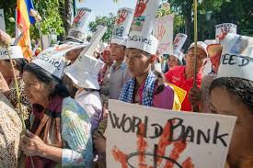
.

Slide 31
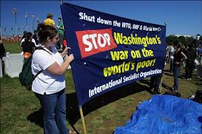
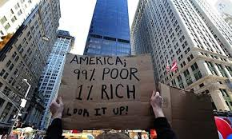
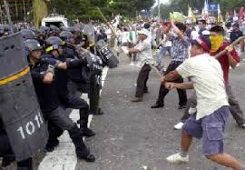
.

Slide 32
.
Awalil Risky & Nasyith Majidi, Neoliberalism Chokes Indonesia (E-Publisher 2008).

Slide 33
Naomi Klein The Shock Doctrine: The Rise of Disaster Capitalism (New York, 2008)
The

Slide 34
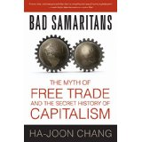
Prof. Haa-Jon Chang, Bad Samaritans: The Myth of Free Trade and the Secret History of Capitalism (2008)
.

Slide 35
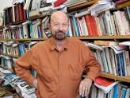
Richard Peet, Unholy Trinity: The IMF, the World Bank and WTO (2010)
.
.

Slide 36
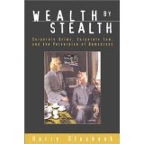
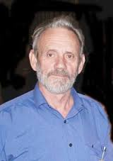
Harry Glasbeek, Wealth by Stealth: Corporate Crime, Corporate Law and the Perversion of Democracy (Toronton, 2002)

Slide 37
Prof. Dr. Noreena Hertz, The Silent Takeover: Global Capitalism and the Death of Democracy (London, 2002)
.

Slide 38
My friends,
that is how I came to know
the danger of neoliberal capitalism.
Thank you!
One of my major missions now and in the days to come is: how can I reach and get as many people as possible and help them come to know this evil economic system and be aware of it and then be able to say no to it and fight against it for their lives. One is through publication!
From this GEM School,
I am expecting: how we can work together to fight against this new face of evil, defending the poor and caring for all God’s creation!O

